Slide 1
Lookup Table (LUT) in VLSI
• Memory-based logic implementation
• Widely used in FPGA and ASIC
• Implements Boolean functions using stored values
Memory-based way to implement digital logic.
Instead of building a Boolean function using logic gates, function’s truth table is stored in memory, and the inputs “look up” correct output
output = table[input]

Slide 2
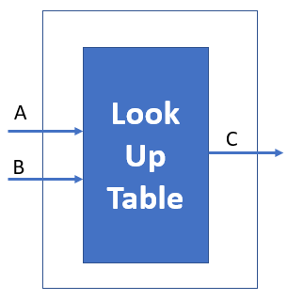
What is a LUT?
LUT stores truth table values
Inputs act as address
Output is selected stored bit
Inputs A and B are the address pins and C is the data pin.
Every time your address pins are changing pointing at a different address entry and they are “reading out” result

Slide 3
LUT Size
N-input LUT requires 2^N memory bits
2-LUT → 4 bits
3-LUT → 8 bits
6-LUT → 64 bits
Realizes Boolean functions by mapping input combinations to pre-stored output values.
A | B | Address | Output
0 | 0 | 00 | f(0,0)
0 | 1 | 01 | f(0,1)
1 | 0 | 10 | f(1,0)
1 | 1 | 11 | f(1,1)

Slide 4
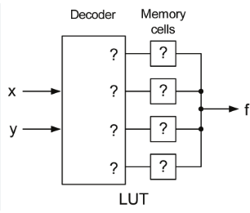
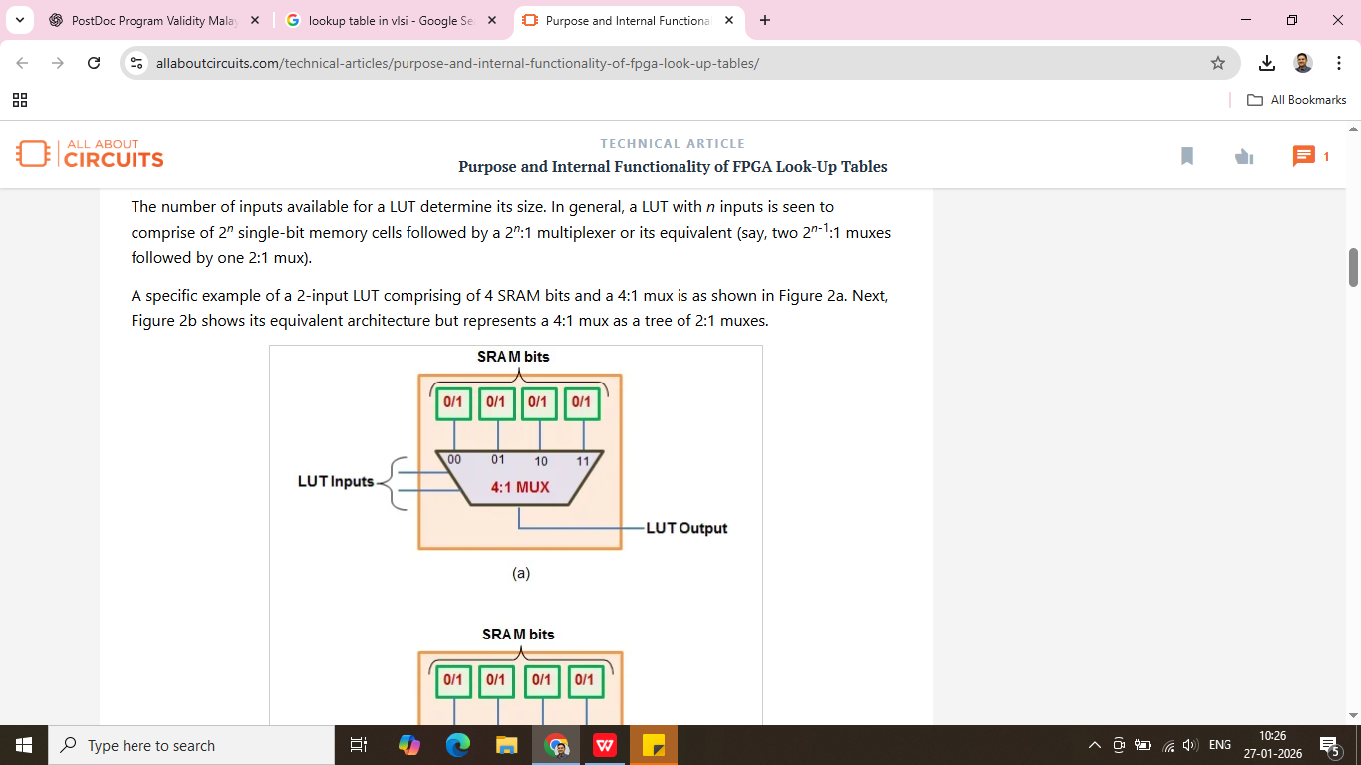
Decoder-Mux based LUT
Inputs ──► Decoder ──► Wordlines
|
Memory Cells (SRAM/ROM)
|
Output
Inputs ──► MUX Tree ──► Output
▲
Stored bits

Slide 5
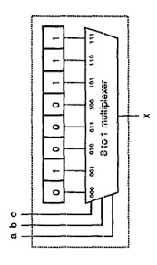

Slide 6
2-Input LUT (XOR)
• Function: A ⊕ B
• Truth Table: 00→0, 01→1, 10→1, 11→0
• Implement using 4-bit memory
module lut2_xor (
input wire A,
input wire B,
output wire Y
);
// 2^2 = 4 bits LUT
wire [3:0] lut_mem = 4'b0110;
assign Y = lut_mem[{A, B}];
endmodule

Slide 7
3-Input LUT (Majority Function) F=AB+BC+AC

Slide 8
4-Input LUT (Custom Boolean Function) F=(A&B) ⊕(C∣D)

Slide 9
LUT Using ROM Style (ASIC-Friendly)
LUT Using output Style (FPGA-Friendly)
module lut_rom (
input [2:0] addr,
output reg Y
);
always @(*)
begin
case (addr)
3'b000: Y = 0;
3'b001: Y = 1;
3'b010: Y = 0;
3'b011: Y = 1;
3'b100: Y = 1;
3'b101: Y = 0;
3'b110: Y = 1;
3'b111: Y = 0;
endcase
end
endmodule
module lut_with_ff (
input clk,
input [2:0] addr,
output reg Y
);
reg [7:0] lut_mem = 8'b11010010;
always @(posedge clk)
Y <= lut_mem[addr];
endmodule

Slide 10
Array in Verilog
An array is a collection of elements of the same data type, accessed using an index.
Vector wire [7:0] mem 8-bit wide signal
1D Array wire [7:0] mem [0:15]; 16 elements → 0 to 15 Each element is 8 bits
mem[0] = 8'hAA; // write
data = mem[5]; // read
2D Array wire [7:0] mem [0:3][0:3]; 4 × 4 matrix Each entry = 8 bits
matrix[1][2] = 8'd15;
data = matrix[row][col];

Slide 11
LUT based Full Adder
module lut_fa(
input A, B, Cin,
output Sum, Cout
);
// Each entry = {Cout, Sum}
reg [1:0] lut_mem [0:7];
initial begin
lut_mem[0] = 2'b00; // 000
lut_mem[1] = 2'b01; // 001
lut_mem[2] = 2'b01; // 010
lut_mem[3] = 2'b10; // 011
lut_mem[4] = 2'b01; // 100
lut_mem[5] = 2'b10; // 101
lut_mem[6] = 2'b10; // 110
lut_mem[7] = 2'b11; // 111
end
assign {Cout, Sum} = lut_mem[{A,B,Cin}];
endmodule
module lut_full_adder (
input A,
input B,
input Cin,
output Sum,
output Cout
);
// 3-input LUTs → 8 entries
wire [7:0] lut_sum = 8'b01101001;
wire [7:0] lut_cout = 8'b00010111;
assign Sum = lut_sum[{A,B,Cin}];
assign Cout = lut_cout[{A,B,Cin}];
endmodule

Slide 12
LUT-Based 4-Bit Ripple Carry Adder
module lut_adder_4bit (
input [3:0] A, B,
input Cin,
output [3:0] Sum,
output Cout
);
wire [4:0] C;
assign C[0] = Cin;
genvar i;
generate
for (i=0; i<4; i=i+1) begin : LUT_FA
lut_full_adder FA (
.A (A[i]),
.B (B[i]),
.Cin (C[i]),
.Sum (Sum[i]),
.Cout(C[i+1])
);
end
endgenerate
assign Cout = C[4];
endmodule

Slide 13
LUT based 2-bit Multiplier
module lut_mul_2x2 (
input [1:0] A,
input [1:0] B,
output [3:0] P
);
// 16-entry LUT, each entry is 4-bit product
reg [3:0] lut [0:15];
initial begin
lut[ 0] = 0; // 0x0
lut[ 1] = 0;
lut[ 2] = 0;
lut[ 3] = 0;
lut[ 4] = 0;
lut[ 5] = 1;
lut[ 6] = 2;
lut[ 7] = 3;
lut[ 8] = 0;
lut[ 9] = 2;
lut[10] = 4;
lut[11] = 6;
lut[12] = 0;
lut[13] = 3;
lut[14] = 6;
lut[15] = 9;
end
assign P = lut[{A,B}];
endmodule

Slide 14
3-bit × 3-bit LUT-Based Multiplier
module lut_mul_3x3 (
input [2:0] A,
input [2:0] B,
output [5:0] P
);
reg [5:0] lut [0:63];
integer i, j;
initial begin
for (i = 0; i < 8; i = i + 1)
for (j = 0; j < 8; j = j + 1)
lut[{i[2:0], j[2:0]}] = i * j;
end
assign P = lut[{A,B}];
endmodule

Slide 15
LUT for Square function Y= x²
module square_lut (x,y);
input [3:0] x;
output [7:0] y;
reg [7:0] table [0:15];
integer i;
initial
begin
for(i=0;i<16;i=i+1)
table[i] = i*i;
end
assign y = table[x];
endmodule

Slide 16
Applications
• FPGA logic
• DSP & AI
• Cryptography
• Hardware obfuscation
✅ Fast logic evaluation
✅ Regular layout (easy routing)
✅ Good for complex Boolean functions
✅ Reconfigurable (FPGA)
✅ Power-efficient for repeated operations

Slide 17
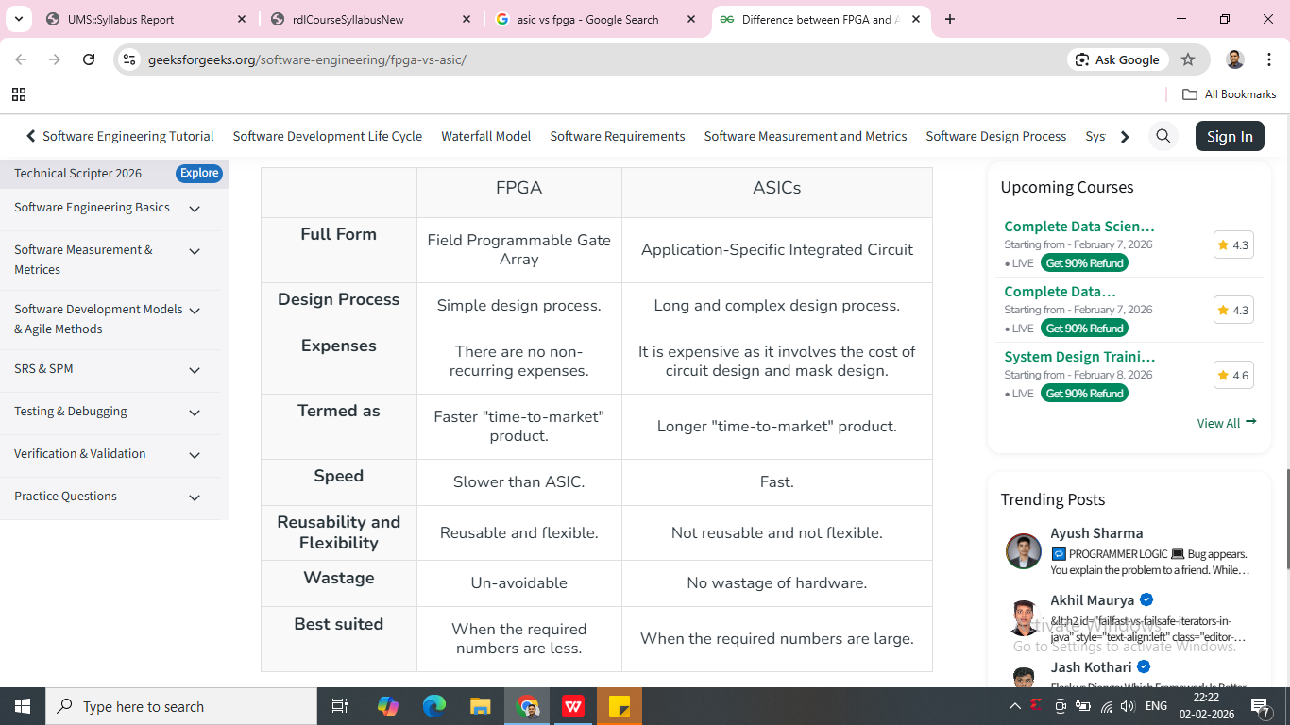
ASIC Vs FPGA
ASIC anf FFPGA are specialized IC
ASICs designed for high-volume, high performance applications
FPGAs offering flexibility, reconfigurability, and rapid prototyping

Slide 18
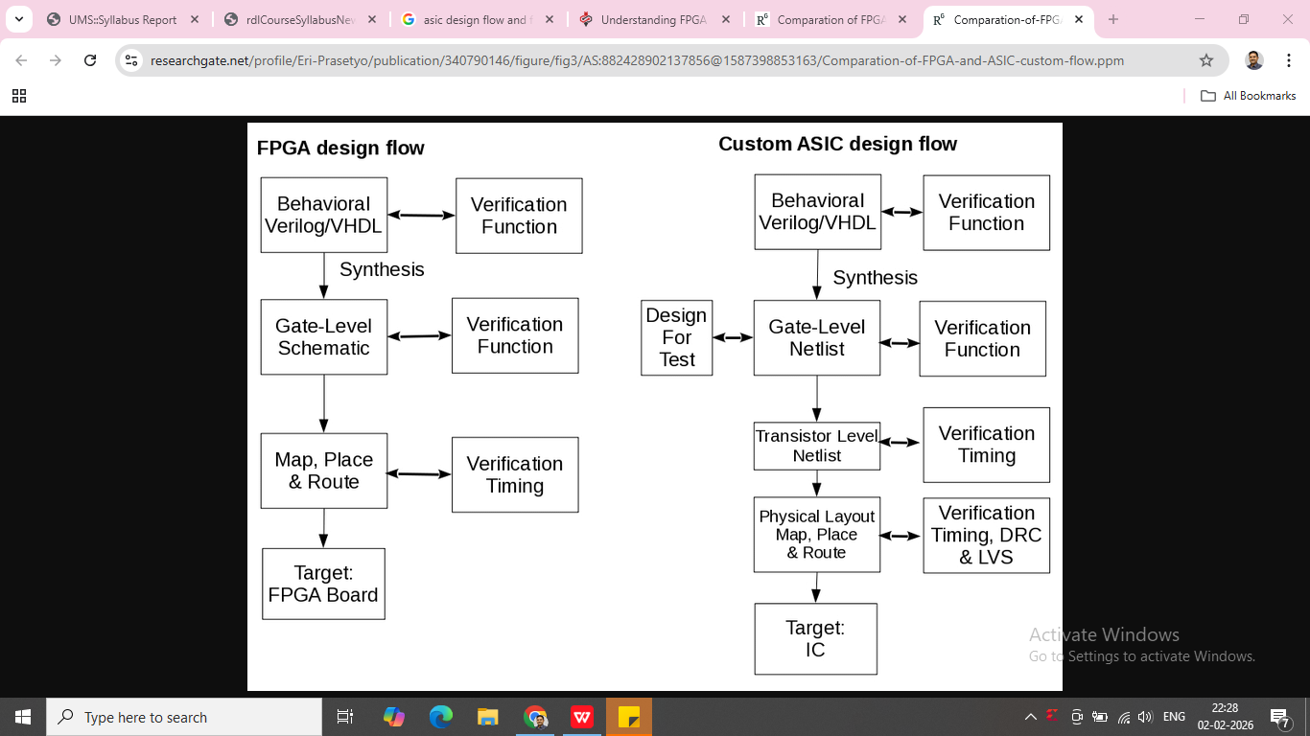

Slide 19
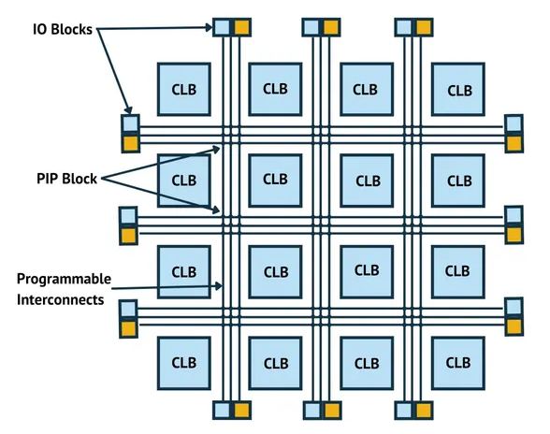
Architecture
FPGA are semiconductor devices that can be programmed and reprogrammed after manufacturing to implement digital logic functions.

Slide 20
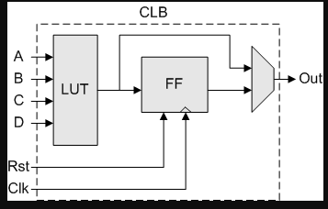
Components of an FPGA
1. Configurable Logic Blocks (CLBs): basic building blocks of an FPGA
containing Look-Up Tables (LUTs), flip-flops, and dedicated arithmetic units.
CLBs configured to perform various combinational and sequential logic functions

Slide 21
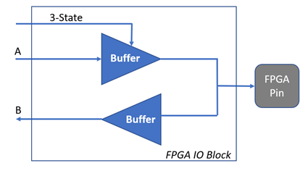
2. Programmable Interconnect Points (PIPs): are programmable switches and wiring resources
Connect CLBs and other components within the FPGA.
PIPs allow for flexible routing and interconnection of signals between different elements on the chip.
3. Input/Output Blocks (IOBs): Interface points between FPGA and external devices or other components on the board.
IOBs are configurable enables the FPGA to communicate with peripherals.
IOB select FPGA pin input, output or tri-state.

Slide 22
4. Block RAM (BRAM): is on-chip memory available on an FPGA, used for storing data and implementing memory functions.
BRAMs are faster than off-chip memory and can be accessed with lower latency.
5. Configuration memory: flash memory that stores the configuration bitstream.
The bitstream is loaded into the FPGA at startup or when reprogramming required.
6. Digital Signal Processing (DSP) Blocks: specialized hardware blocks dedicated to performing arithmetic operations, multiplication and accumulation, at high speeds. DSP blocks are commonly used in signal processing and filtering applications.
7. Clock management resources: Phase-Locked Loops (PLLs) and Digital Clock Managers (DCMs) used to generate, distribute, and manage clock signals within FPGA. These resources help maintain precise timing and synchronization across the device.

Slide 23
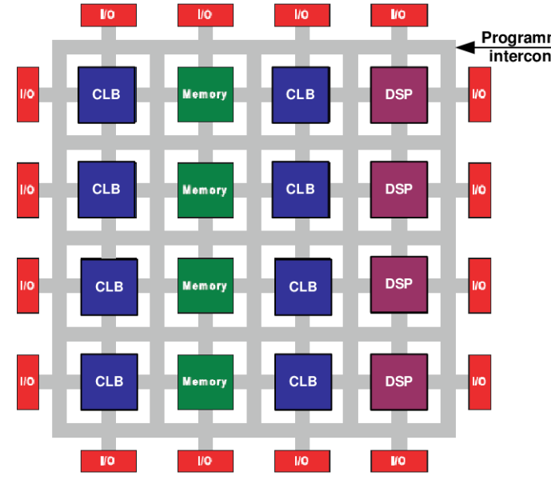

Slide 24
Example
f(A,B,C) = (A.B)XOR C
primary component within a CLB is LUT (Look-Up Table), stores pre-computed results of a Boolean function.
A | B | C | AB XOR C
0 | 0 | 0
0 | 0 | 1
0 | 1 | 0
0 | 1 | 1
1 | 0 | 0
1 | 0 | 1
1 | 1 | 0
1 | 1 | 1
3-input LUT (LUT3), 2^3 = 8 memory cells
Memory Content = [0, 1, 0, 1, 0, 1, 1, 0]
D Flip-Flop (DFF): An edge-triggered register. The input D receives the LUT result.

Slide 25
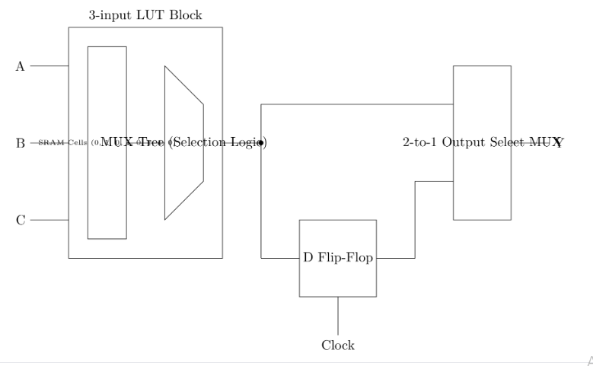
Signal from a dedicated SRAM Configuration Cell located within the FPGA's configuration memory.
0 => Combinational Mode, Y is driven directly by the LUT.
1 => Sequential Mode, Y is driven by the D Flip-Flop (synchronized to the clock).

